Slide 1


<Technology-Trend-Analysis>
<Kai Hung Ho>
<12-Apr-2023>

Slide 2

OUTLINE
Executive Summary
Introduction
Methodology
Results
Visualization – Charts
Dashboard
Discussion
Findings & Implications
Conclusion
Appendix

Slide 3

EXECUTIVE SUMMARY
Web Development Technology Insights
In this presentation, we will share key findings and recommendations based on the data analysis of the top programming languages, databases, platforms, and web frameworks that used by developers.

Slide 4

INTRODUCTION
Intro
•Analyze the current technology trend around the world.
AnalysisPurpose
•Identify the high demand programming languages, databases, platforms and frameworks
•Identify what will be the trend in the future
•Identify the human resource gap in the market
Stakeholders
•People from IT industries
•Data Analyst
•Students

Slide 5

METHODOLOGY
Data Collection: The data in this project is collected through a online survey which conducted by Stack Overflow.
Data Cleaning and Wrangling: The dataset has been cleaned and prepared for analysis. This nvolved removing any inconsistencies, errors, or missing values, as well as transforming data into a suitable format for analysis.
Data Exploration: Data visualization tools IBM Cognos has been used to explore the insights of the data.
Data analysis: After data exploration, this project has summarized and analyzed the data using appropriate statistical measures, such as frequencies, percentages, proportions, averages, and other relevant metrics. This helps in understanding the patterns, trends, and relationships present in the data.

Slide 6
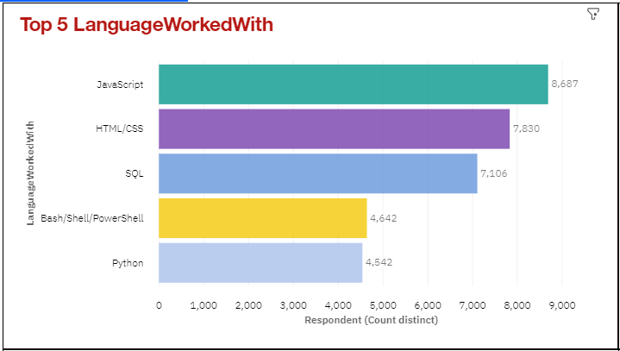
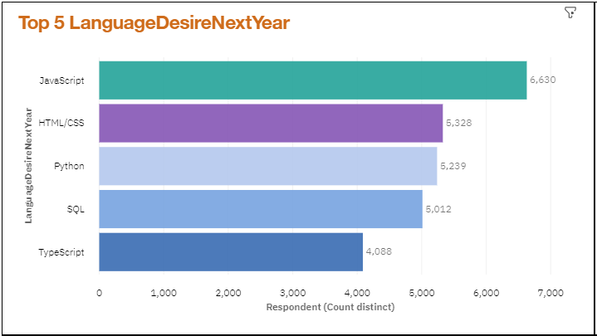
PROGRAMMING LANGUAGE TRENDS
Current Year
Next Year

Slide 7
PROGRAMMING LANGUAGE TRENDS - FINDINGS & IMPLICATIONS
Findings
JavaScript and HTML/CSS are the most commonly used languages:
The data shows that JavaScript and HTML/CSS are the top two languages that developers have worked with, indicating their widespread use in web development.
Python is a popular desired language for the future:
While Python ranks fifth in the list of languages developers have worked with, it ranks third in the list of desired languages for the next year. This suggests that developers have a growing interest in Python and may be planning to learn and use it more in the future.
TypeScript is gaining popularity:
While TypeScript does not appear in the list of top languages developers have worked with, it ranks fifth in the list of desired languages for the next year. This suggests that TypeScript, a statically-typed superset of JavaScript, is gaining popularity and may see increased adoption in the near future.
Implications
JavaScript and HTML/CSS skills are still in demand:
As the most commonly used languages, JavaScript and HTML/CSS skills continue to be in high demand in the job market. Developers who are proficient in these languages are likely to have a wide range of opportunities for web development projects.
Python is a valuable skill to acquire:
With Python ranking high in the list of desired languages for the next year, developers who learn and master Python can position themselves well for future job opportunities. Python's versatility and extensive use in various domains, such as data science, machine learning, and web development, make it a valuable skill to acquire.
TypeScript is an emerging technology to watch:
The growing interest in TypeScript, as indicated by its ranking in the list of desired languages for the next year, suggests that it is an emerging technology to watch. Developers who want to stay ahead of the curve may consider learning TypeScript to enhance their skills and stay relevant in the ever-evolving field of web development.

Slide 8
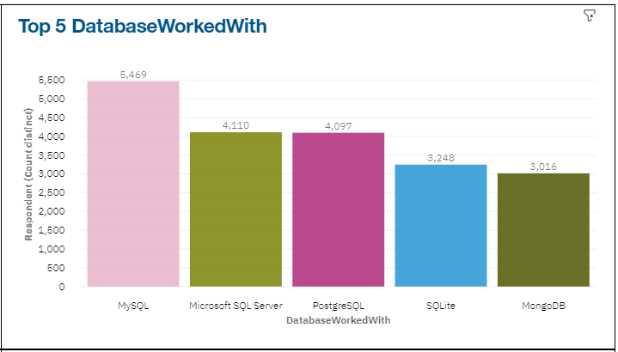
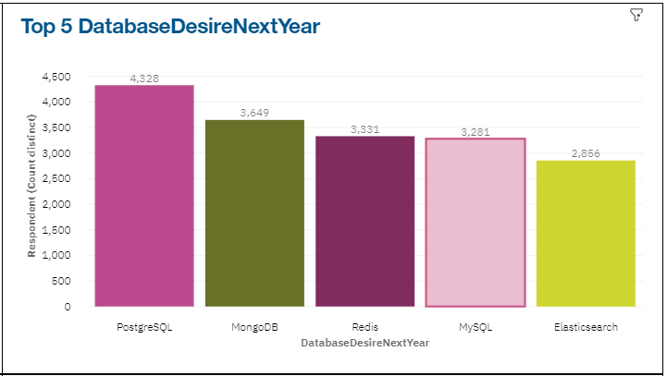
DATABASE TRENDS
Current Year
Next Year

Slide 9
DATABASE TRENDS - FINDINGS & IMPLICATIONS
Findings
MySQL and PostgreSQL are the most commonly used databases:
The data shows that MySQL and PostgreSQL are the top two databases that developers have worked with, indicating their widespread use in web development projects.
MongoDB is a popular desired database for the future:
While MongoDB ranks fifth in the list of databases developers have worked with, it ranks second in the list of desired databases for the next year. This suggests that developers have a growing interest in MongoDB and may be planning to use it more in the future.
Redis and Elasticsearch are gaining popularity:
While Redis and Elasticsearch do not appear in the list of top databases developers have worked with, they rank third and fifth, respectively, in the list of desired databases for the next year. This suggests that these databases are gaining popularity and may see increased adoption in the near future.
Implications
MySQL and PostgreSQL skills are still in demand:
As the most commonly used databases, MySQL and PostgreSQL skills continue to be in high demand in the job market. Developers who are proficient in these databases are likely to have a wide range of opportunities for web development projects.
MongoDB is a valuable skill to acquire:
With MongoDB ranking high in the list of desired databases for the next year, developers who learn and master MongoDB can position themselves well for future job opportunities. MongoDB's document-oriented NoSQL database model makes it popular for modern web applications that require flexibility and scalability in handling large amounts of data.
Redis and Elasticsearch are emerging technologies to watch:
The growing interest in Redis and Elasticsearch, as indicated by their ranking in the list of desired databases for the next year, suggests that they are emerging technologies to watch. Developers who want to stay ahead of the curve may consider learning Redis and Elasticsearch to enhance their skills and stay relevant in the ever-evolving field of web development and data management.

Slide 10

DASHBOARD
https://dataplatform.cloud.ibm.com/dashboards/fb8fa761-430c-40c8-a317-cf0990243396/view/0200f12102ee1ee76edeeae4079b7f5275637009e0bb865583d37b490f677797f03d1291c82a4d09d3405760fbec1b0fce

Slide 11
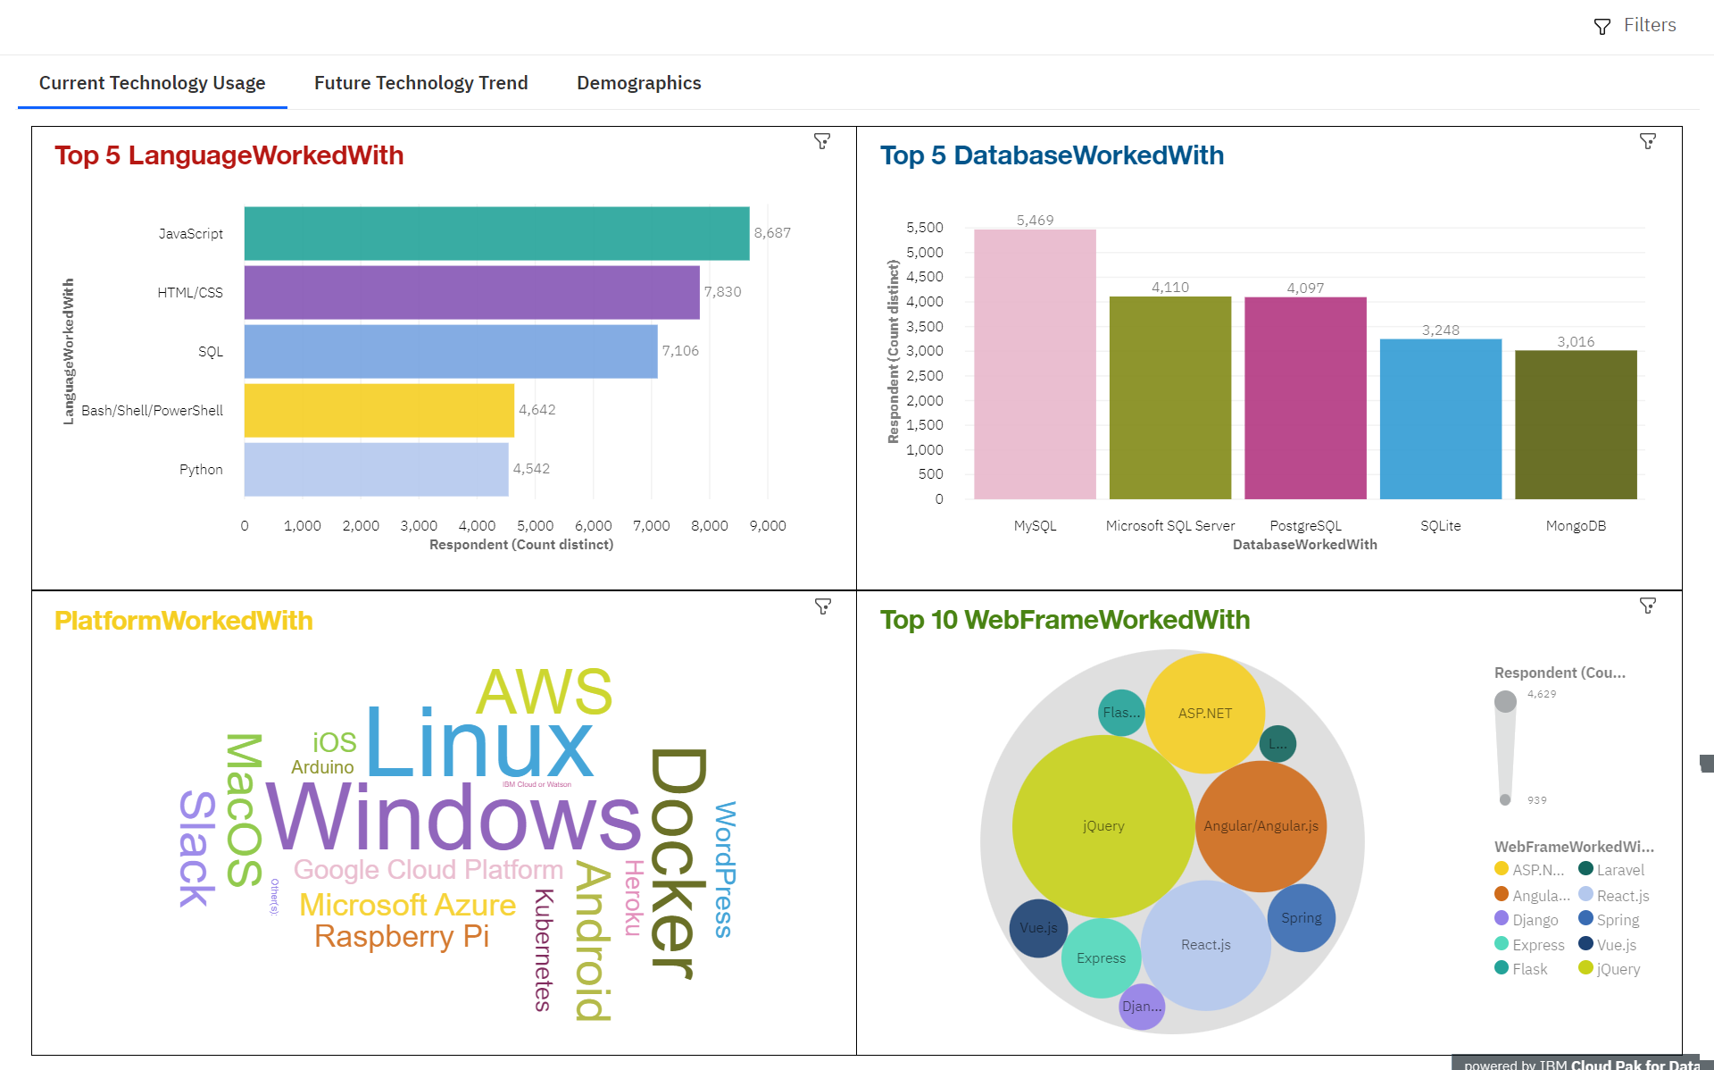
DASHBOARD TAB 1

Slide 12
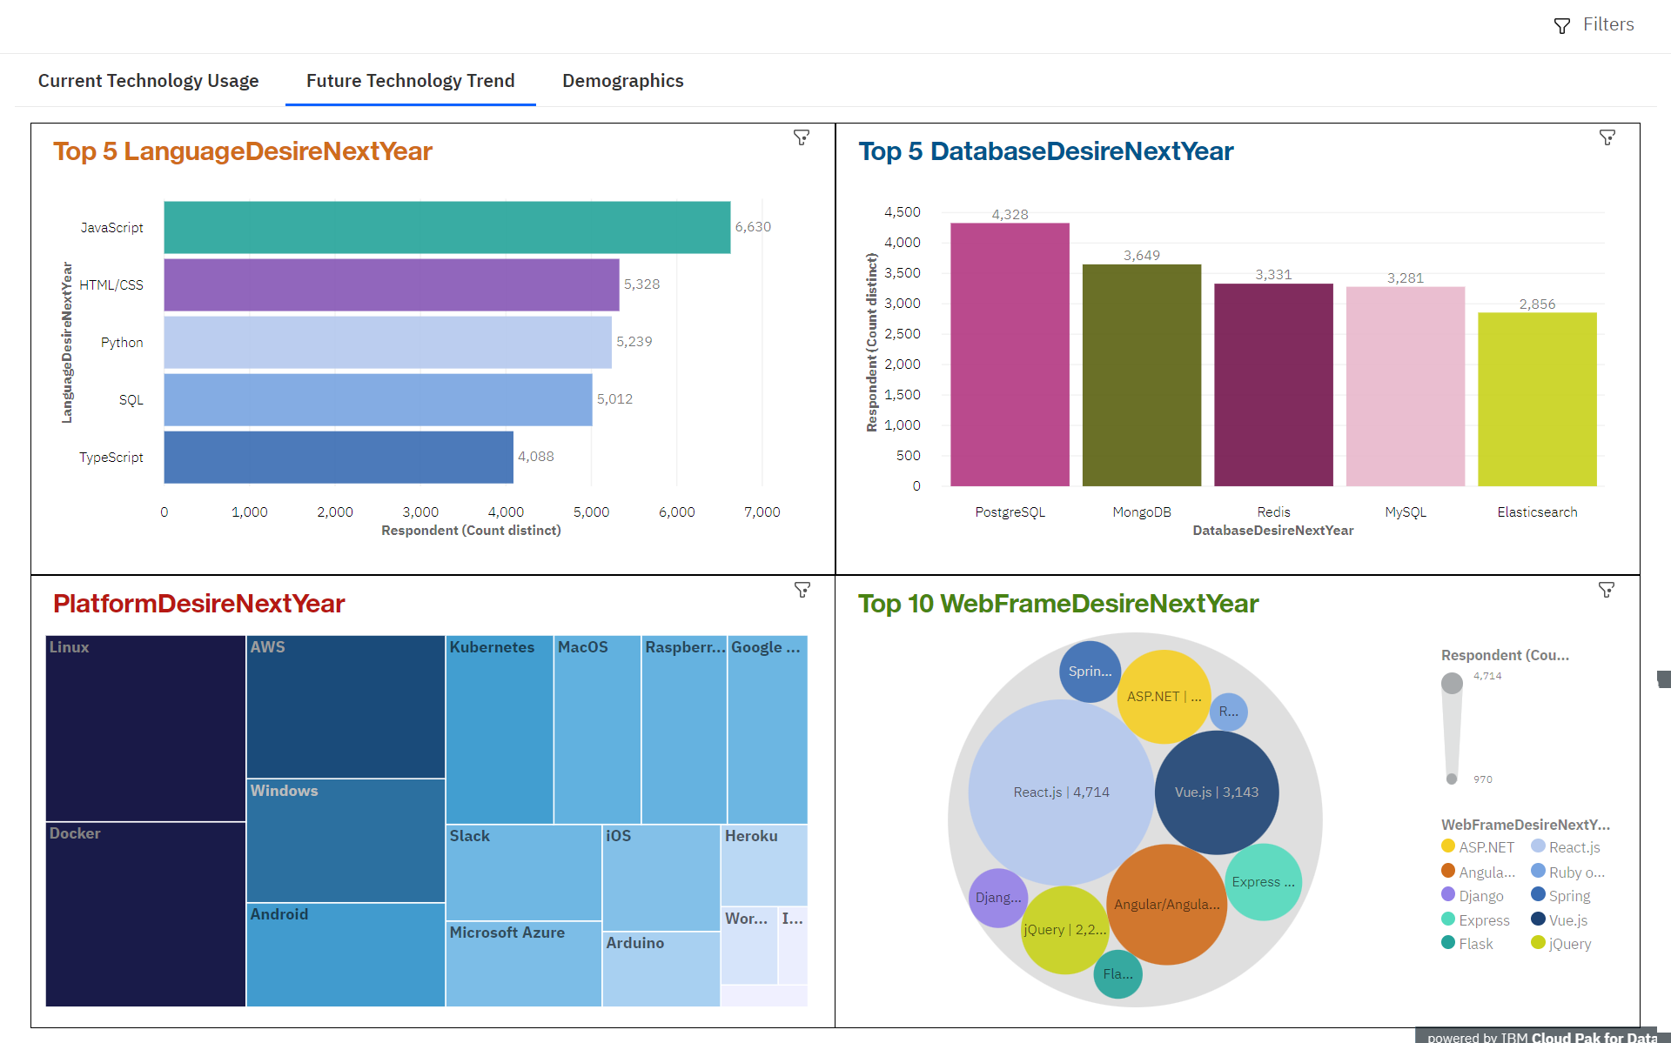
DASHBOARD TAB 2

Slide 13
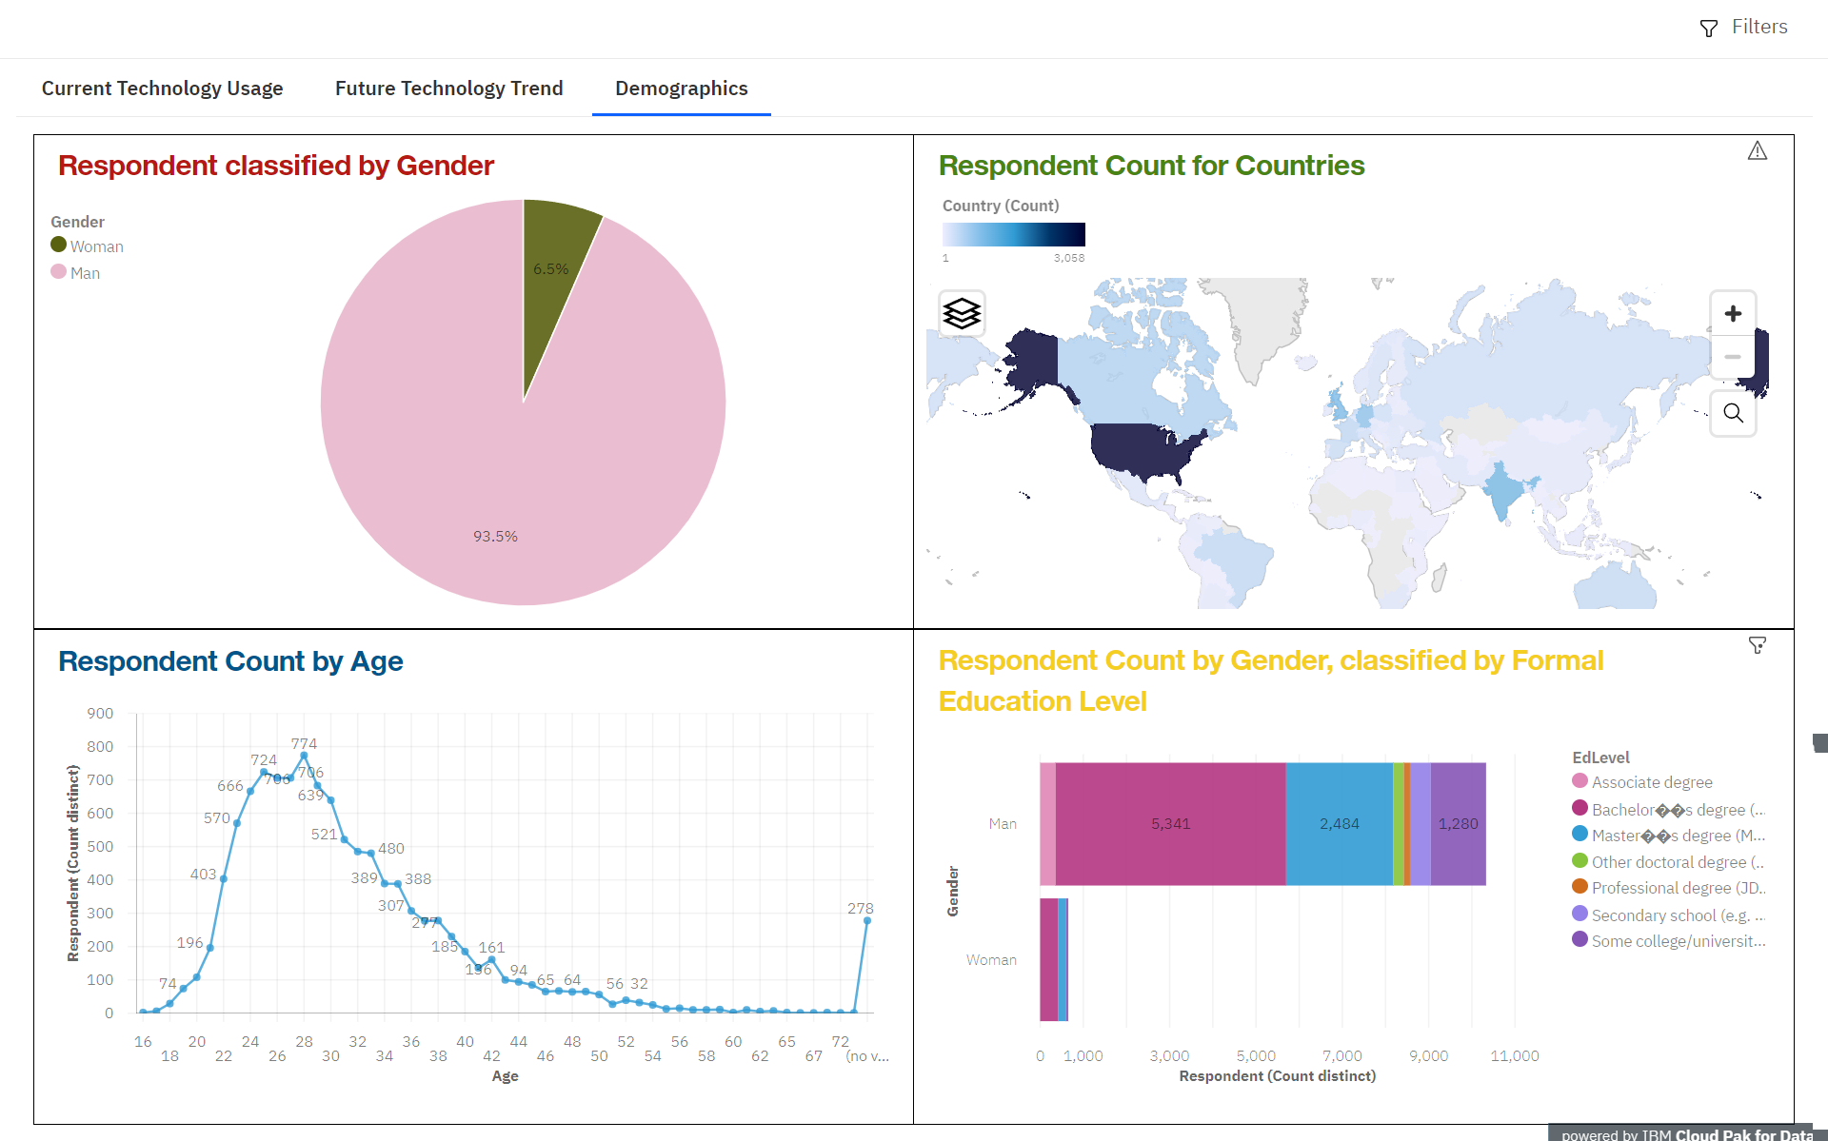
DASHBOARD TAB 3

Slide 14
DISCUSSION
How a devloper can stay up-to-date with the latest technologies

Slide 15
OVERALL FINDINGS & IMPLICATIONS
JavaScript is the most commonly used programming language and remains the top choice for developers in both the current year and their desired language for the next year. This highlights the continued dominance and importance of JavaScript in the field of web development. Organizations and developers should continue to invest in JavaScript skills and stay updated with the latest developments in the language.
There is a significant demand for front-end web technologies such as HTML/CSS, React.js, and Vue.js, as evidenced by their high rankings in both the most used and desired frameworks. This indicates the importance of user interface (UI) and user experience (UX) development in the current landscape of web development. Organizations should prioritize front-end technologies in their development efforts to deliver engaging and responsive web experiences to users.
Open-source platforms and databases such as Linux, Docker, PostgreSQL, and MongoDB are widely used and desired by developers, indicating the growing popularity of open-source technologies in the development community. Organizations can leverage the benefits of open-source technologies, including cost-effectiveness, community support, and flexibility, in their development projects.

Slide 16

CONCLUSION
JavaScript remains the dominant programming language in the field of web development, and organizations should prioritize investing in JavaScript skills and staying updated with the latest developments.
Front-end technologies such as HTML/CSS, React.js, and Vue.js are in high demand, indicating the importance of delivering engaging user experiences on the web.
Open-source platforms and databases are popular among developers, and organizations can benefit from leveraging the advantages of open-source technologies in their development efforts.
Organizations should stay informed about the latest trends and technologies in the web development landscape to ensure they are keeping up with the evolving demands of the industry and staying competitive in the market.

Slide 17

APPENDIX
Include any relevant additional charts, or tables that you may have created during the analysis phase.

Slide 18
JOB POSTINGS

Slide 19
POPULAR LANGUAGES

